Slide 1
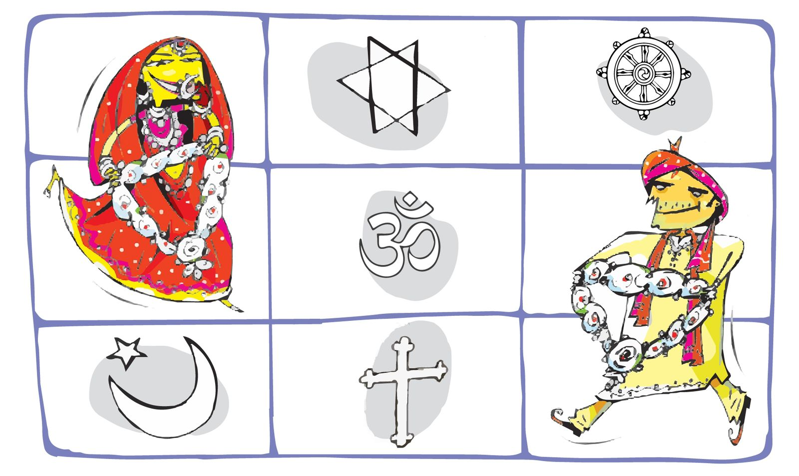
Interfaith Marriages
Dilip Amin, Ph. D.
March 28, 2025
Many photos here may be used without owner’s permission and are used here for a non-profit educational purpose
Notes:
For what to say, visit https://docs.google.com/document/d/1VQP51_aEPiGFc4rZ58x7rWRemYTREZwNif4ZsMza0fw/edit?tab=t.0
Reach out to Dr. Dilip Amin at InterfaithShaadi@gmail.com for any help.

Slide 2
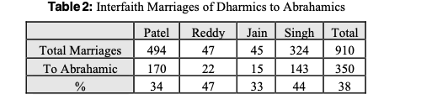

Dharmic-Abrahamic Marriages in America
Page 15 of the book
Page 2
© 2025 InterfaithShaadi

Slide 3
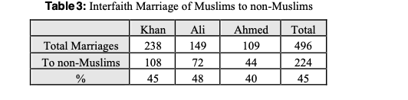
Marriages of Muslims in America
Shafaq Mayat and Dilip Amin, page 17 of the book
Page 3
© 2025 InterfaithShaadi

Slide 4
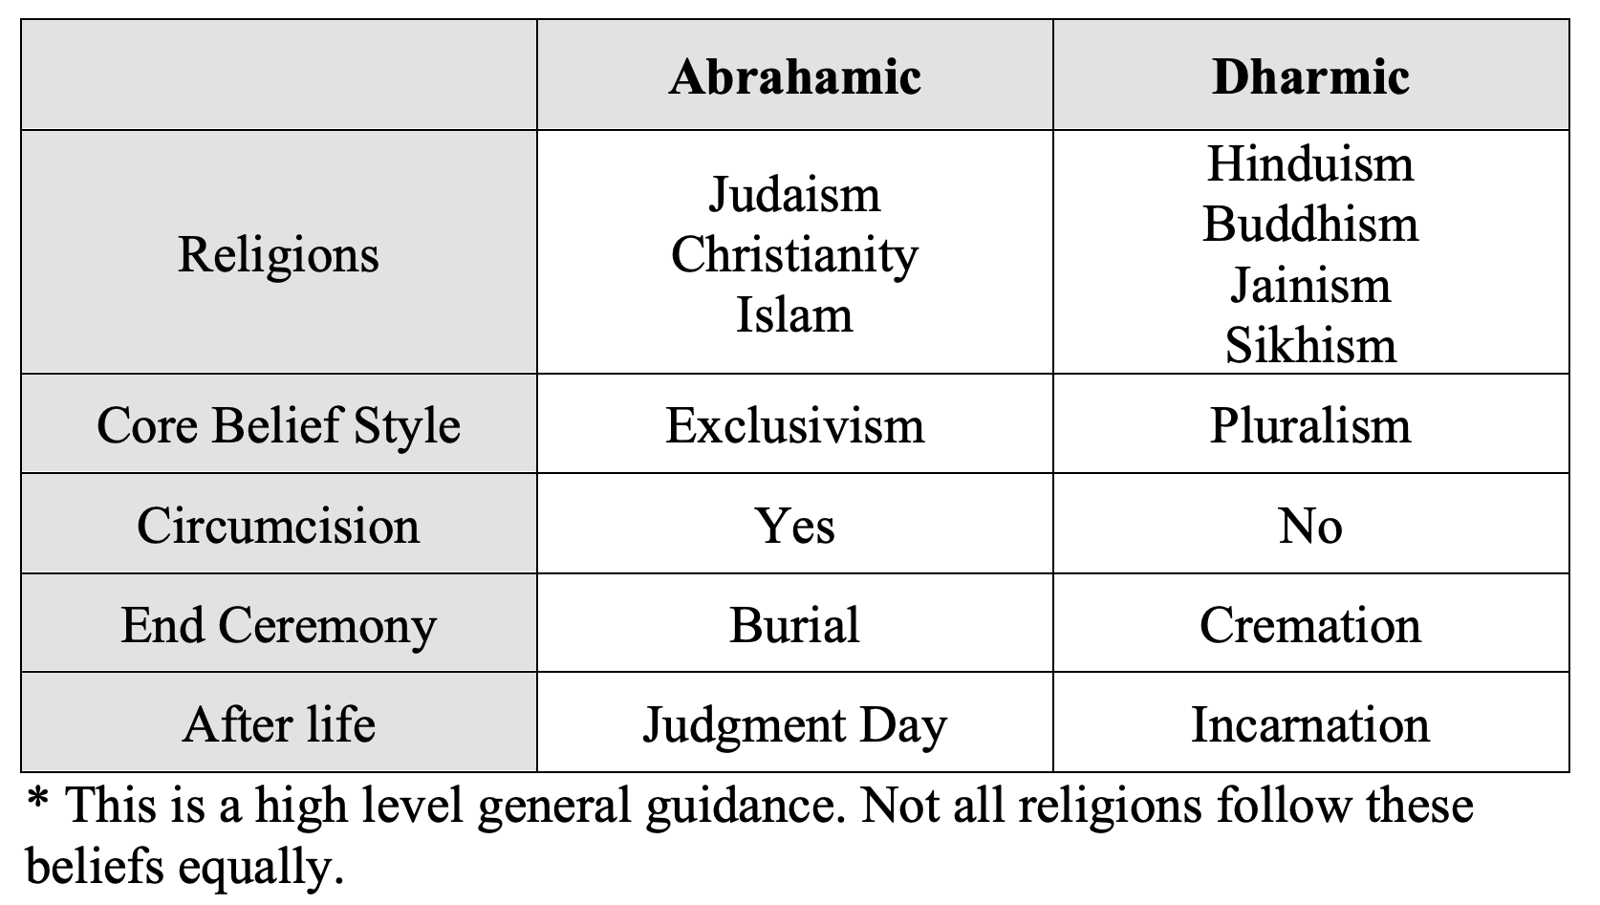
Dharmic vs. Abrahamic
Page 2 of the book
Page 4
© 2025 InterfaithShaadi

Slide 5

Love Progression (Location: College Dorm)
  Pluralist, secular
  There is One God, why fight?
  Sympathy game
  Spend money, 10X love
  Discussion on--Who is God? Why don’t you explore your own faith?
  “Sorry can’t marry because my mother…” convert, convert, convert!
Page 5
© 2025 InterfaithShaadi

Slide 6
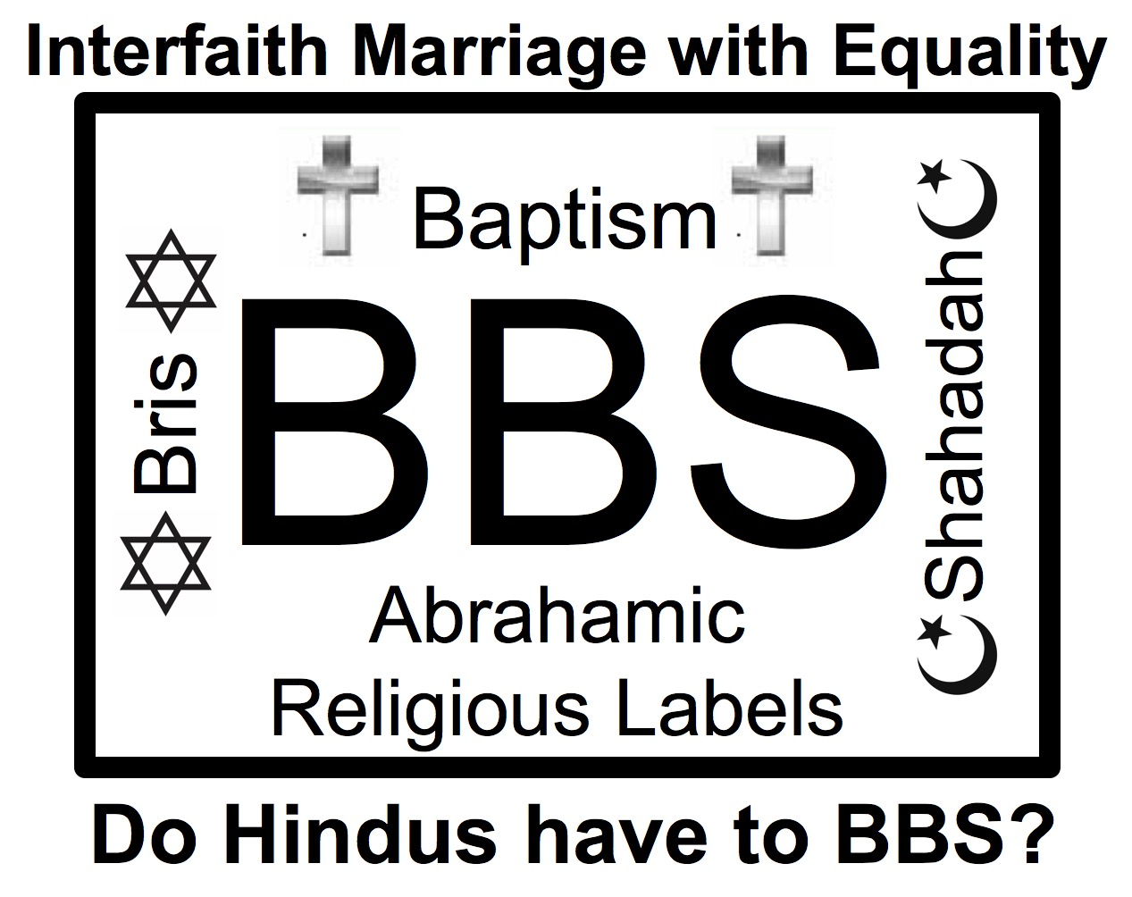
On the Day (Location: Your Dinner Table)
A big surprise!
  “Mom, I am in love with Muhammad”
  “Dad: I am in love with Jennifer”NO
Normal reaction
  “I told you not to marry Interfaith”
  “Muslims/Christians are bad”
Be realistic, collect facts
  Just listen to your child
  Visit their mosque/church
Propose - Share & Respect with Equality
  50%-50%
Propose: NO BBS
Available on Amazon
Page 6
© 2025 InterfaithShaadi

Slide 7
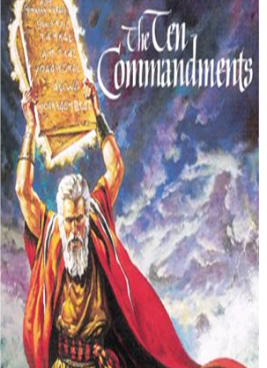
The Ten Commandments
"I am the Lord your God. You shall have no other gods before me. You shall not make for yourself an idol, whether in the form of anything that is in heaven above, or that is on the earth beneath, or that is in the water under the earth. You shall not bow down to them or worship them; for I the Lord your God am a jealous God… punishing children for the iniquity of parents, to the third and fourth generations of those who reject me"
(Exodus 20:4-5; page 259)
Bible:
“Jealous God” 31 times
“Angry God” 238 times
“fear” is used 455 times
Page 7
© 2025 InterfaithShaadi

Slide 8

Christian Exclusivism
Christians believe that Jesus is Son of God and that faith in Jesus is the only way to achieve salvation and to enter heaven
Jesus said: "I am the way, the truth, and the life. No one comes to the father (God) except through me”
A non-Baptized carries sin
Page 8
© 2025 InterfaithShaadi

Slide 9
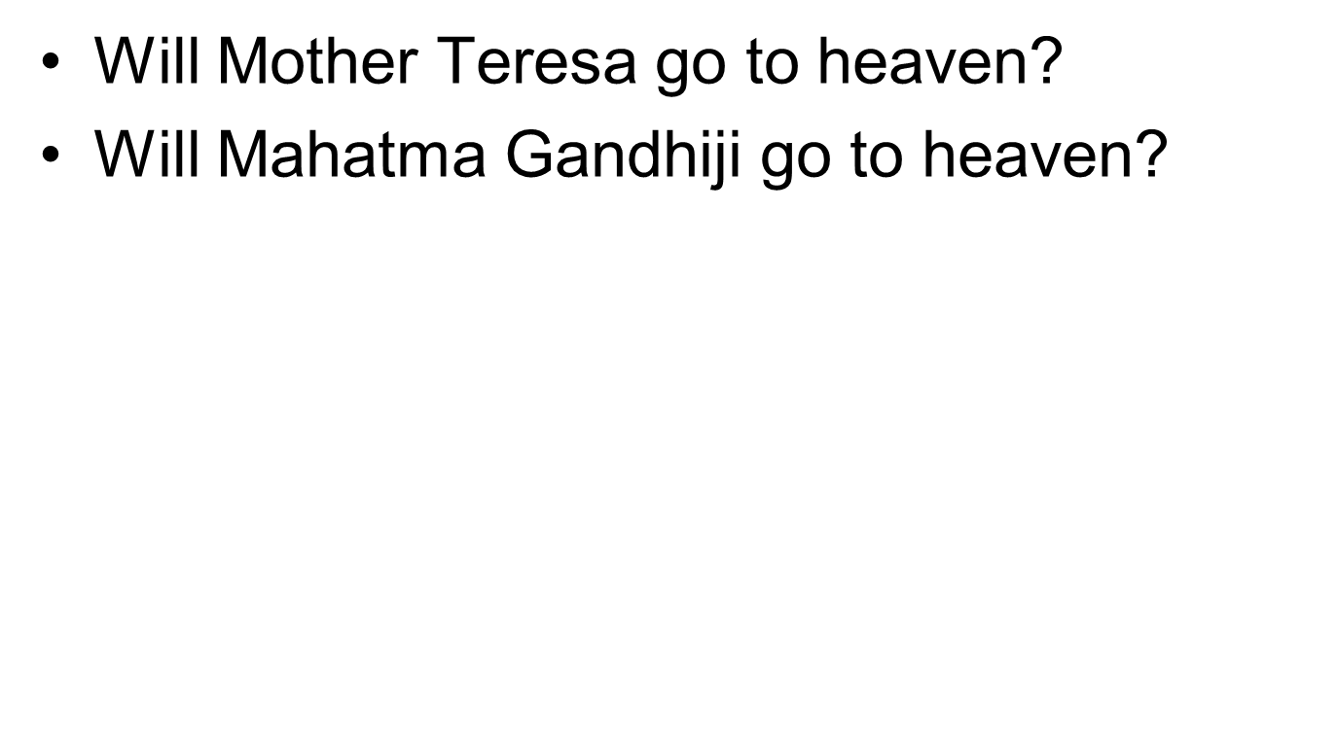
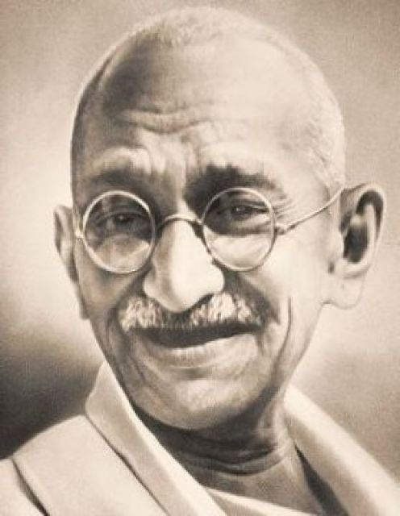
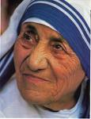
Those who is Baptized will go to heaven,
all others go to eternal hell
Page 9
© 2025 InterfaithShaadi

Slide 10
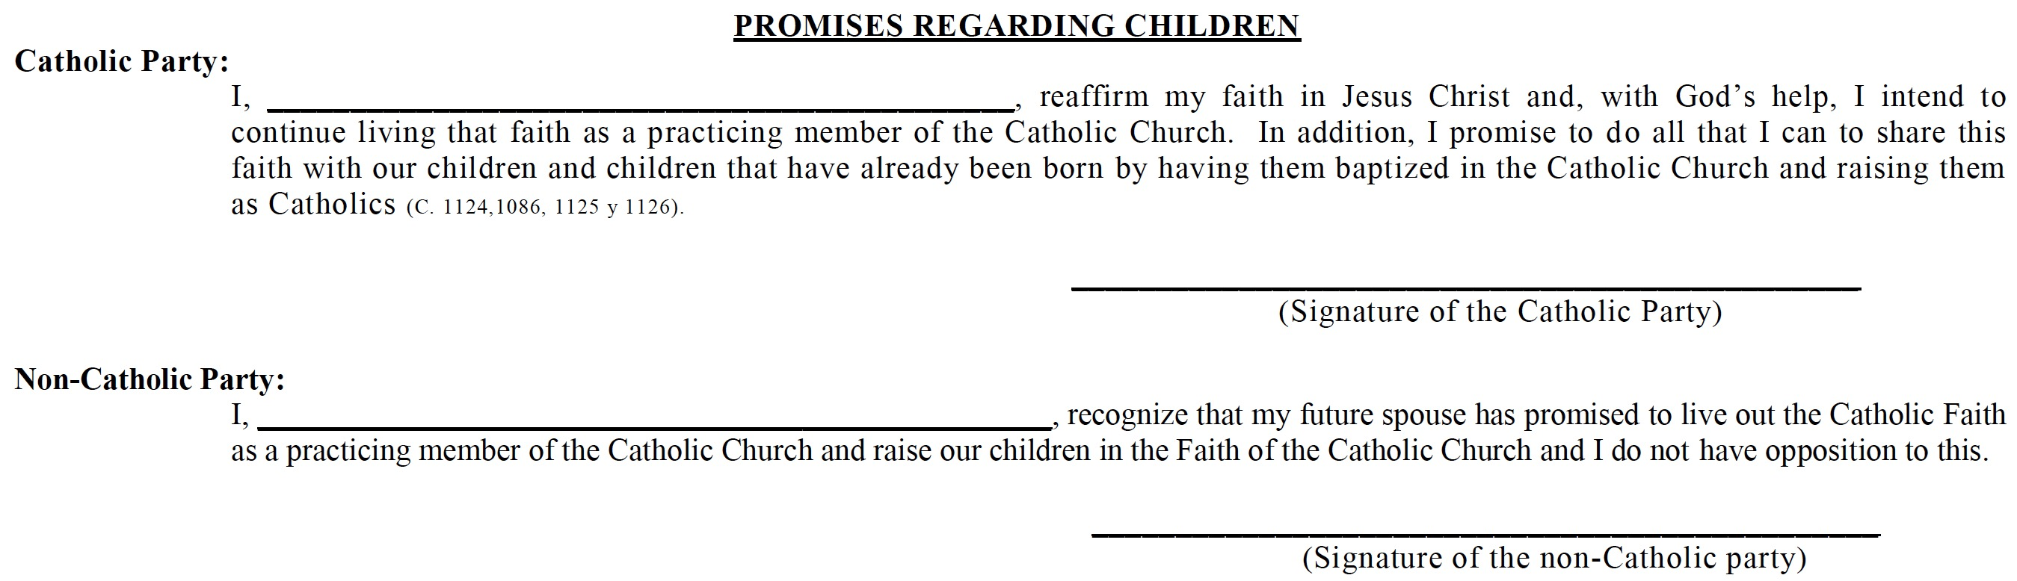

Pre-Nuptial Required for the Church Weddings
Skip-generation Conversion
Page 10
© 2025 Hindu University of America.

Slide 11
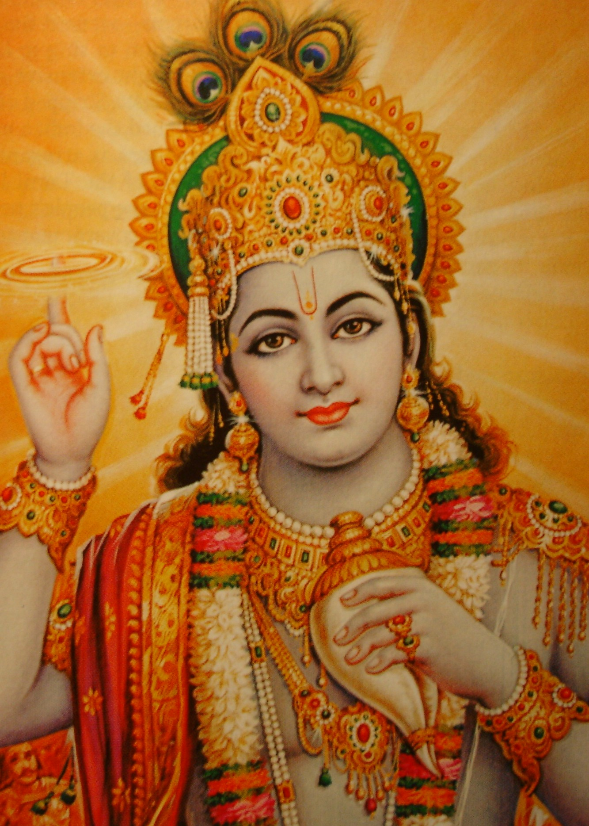
Exclusivism in Geeta
Everyone follows My path in all respects [Geeta 4:11]
The fools disregard Me, dwelling in human form [9:11]
Those who are devotees of other gods and who worship them with faith actually worship only Me, but they do so in a wrong way [9:23]
Abandon all varieties of religion* and just surrender unto Me [18:66]
*Actual word is dharma and not religion
Page 255 of the book
Page 11

Slide 12
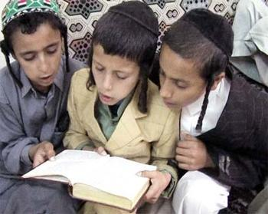
Jewish Exclusivism
Jews are “chosen people”
Jesus, Allah or Idol worship is intolerable
Without Bris (circumcision), something negative will happen to a child
Page 12
© 2025 InterfaithShaadi

Slide 13
Koran on Non-believers
[4:56] Those that deny Our revelations We will burn (them) in fire. No sooner will their skins be consumed than We shall give them other skins, so that they may truly taste the scourge
[4:91] ..lay hold of them (unbelievers) and kill them wherever you find them. Over such men We give you absolute authority
[47:4] When you meet the unbelievers in the battlefield strike off their heads and, when you have laid them low, bind your captives firmly. Thus shall you do. Had God willed, He could Himself have punished them; (but He has ordained it to you) that He may test you, the one by the other
Page 283 of the book
Page 13
© 2025 InterfaithShaadi

Slide 14
Koran on Interfaith Marriages
Koran 2:221: You shall not wed pagan/mushrik woman, unless they embrace the faith. A believing slave girl is better than an idolatress, though she may please you
Muslim men can marry “People of Book” without conversion but children must be raised as Muslim only
Koran 60:11: Do not maintain your marriage with unbelieving women (no zina)
Bukhari 9.84.57: Muhammad: “Whoever changes his Islamic religion, then kill him.”
Koran 24:30: Lower your gaze. Enjoin believing men to turn their eyes away from temptation and to restrain their carnal desires
Page 14
© 2025 InterfaithShaadi

Slide 15
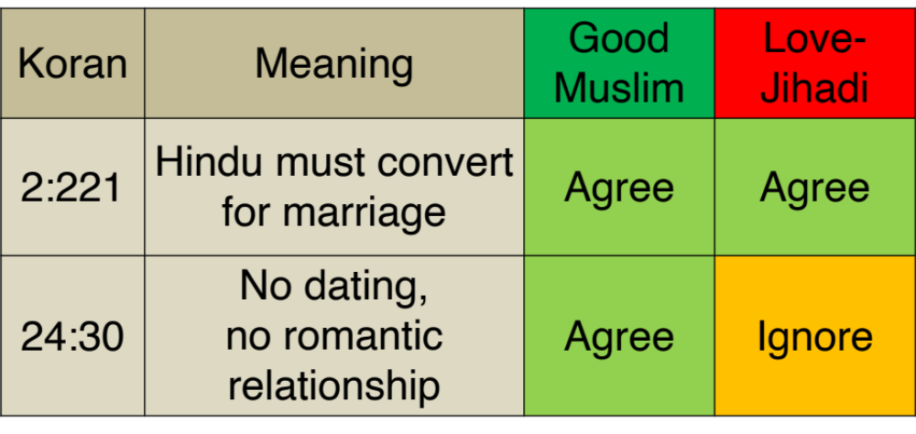
A True Muslim vs a Potential Love-Jihadi
Page 15
© 2025 Hindu University of America.

Slide 16


Saif-Amrita:
Saif: “She had to fall in line and go through only a nikaah” (and she did).
Two children raised as Muslims.
Now got divorce.
Saif-Kareena:
Saif: “That is a trouble with religion, it expects conversion. I don’t buy it …anymore”
Amrita Converted!
Children Muslim names
Kareena did not convert
Children Taimur and Jehangir
Page 16
© 2025 InterfaithShaadi

Slide 17
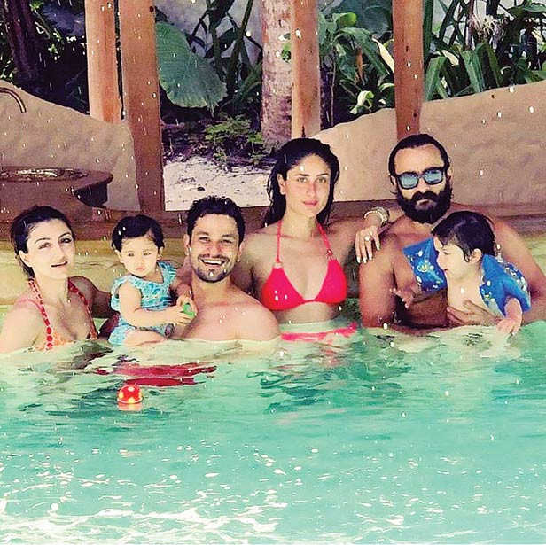
Soha Ali Khan Married Kunal Khemu, a Hindu
Daughter:
First Name: Inaaya, based on the Koran
Middle Name: Naumi, because was born on MahaNavmi
Can sign Gayatri mantra
Ties rakhi to Taimur
Child’s Name count!
Page 17
© 2025 InterfaithShaadi

Slide 18
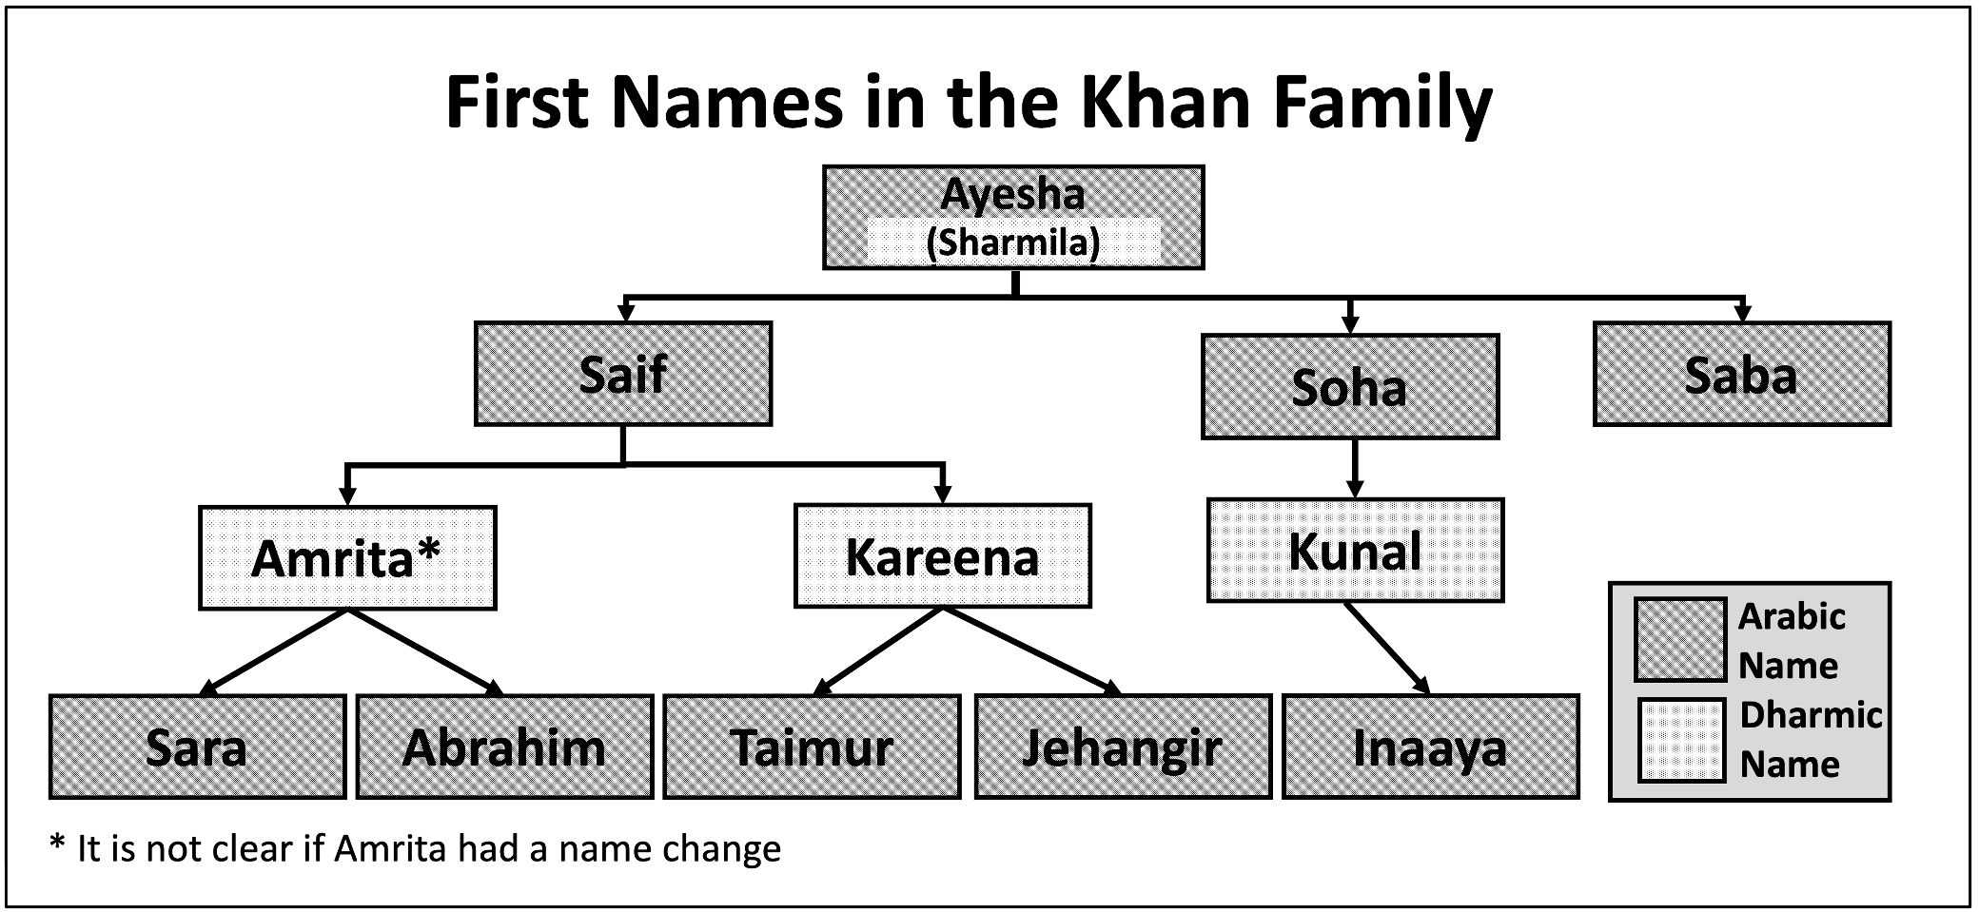
First Names of Khans
Skip-generation Conversion
Page 18
© 2025 InterfaithShaadi

Slide 19
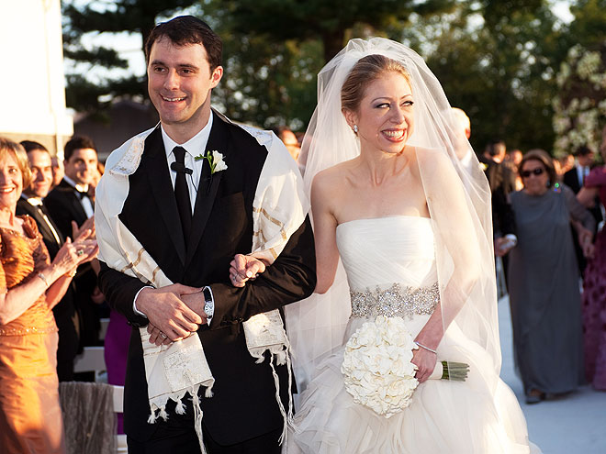
Jewish-Christian Marriage (Good, Bad and Ugly)
Chelsea Clinton is still a Christian-Methodist
Page 19
© 2025 InterfaithShaadi

Slide 20
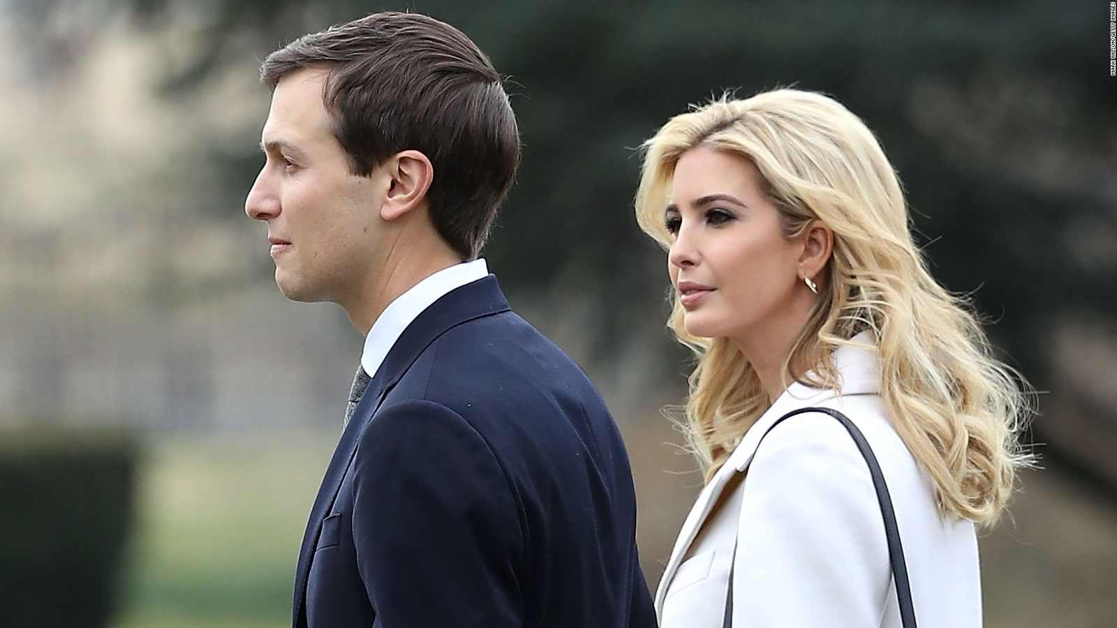
Jewish-Christian Marriage (Good, Bad and Ugly)
Ivanka Trump converted to Judaism to marry Jared Kushner
Page 20
© 2025 InterfaithShaadi

Slide 21
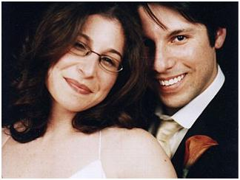
Jewish-Christian Marriage (Good, Bad and Ugly)
Joseph converted to marry Rebecca
Child should be Jewish
Joseph baptized the baby! Duel labels (Bris and Baptism) is not possible!!
Fake-conversion
Page 21
© 2025 InterfaithShaadi

Slide 22
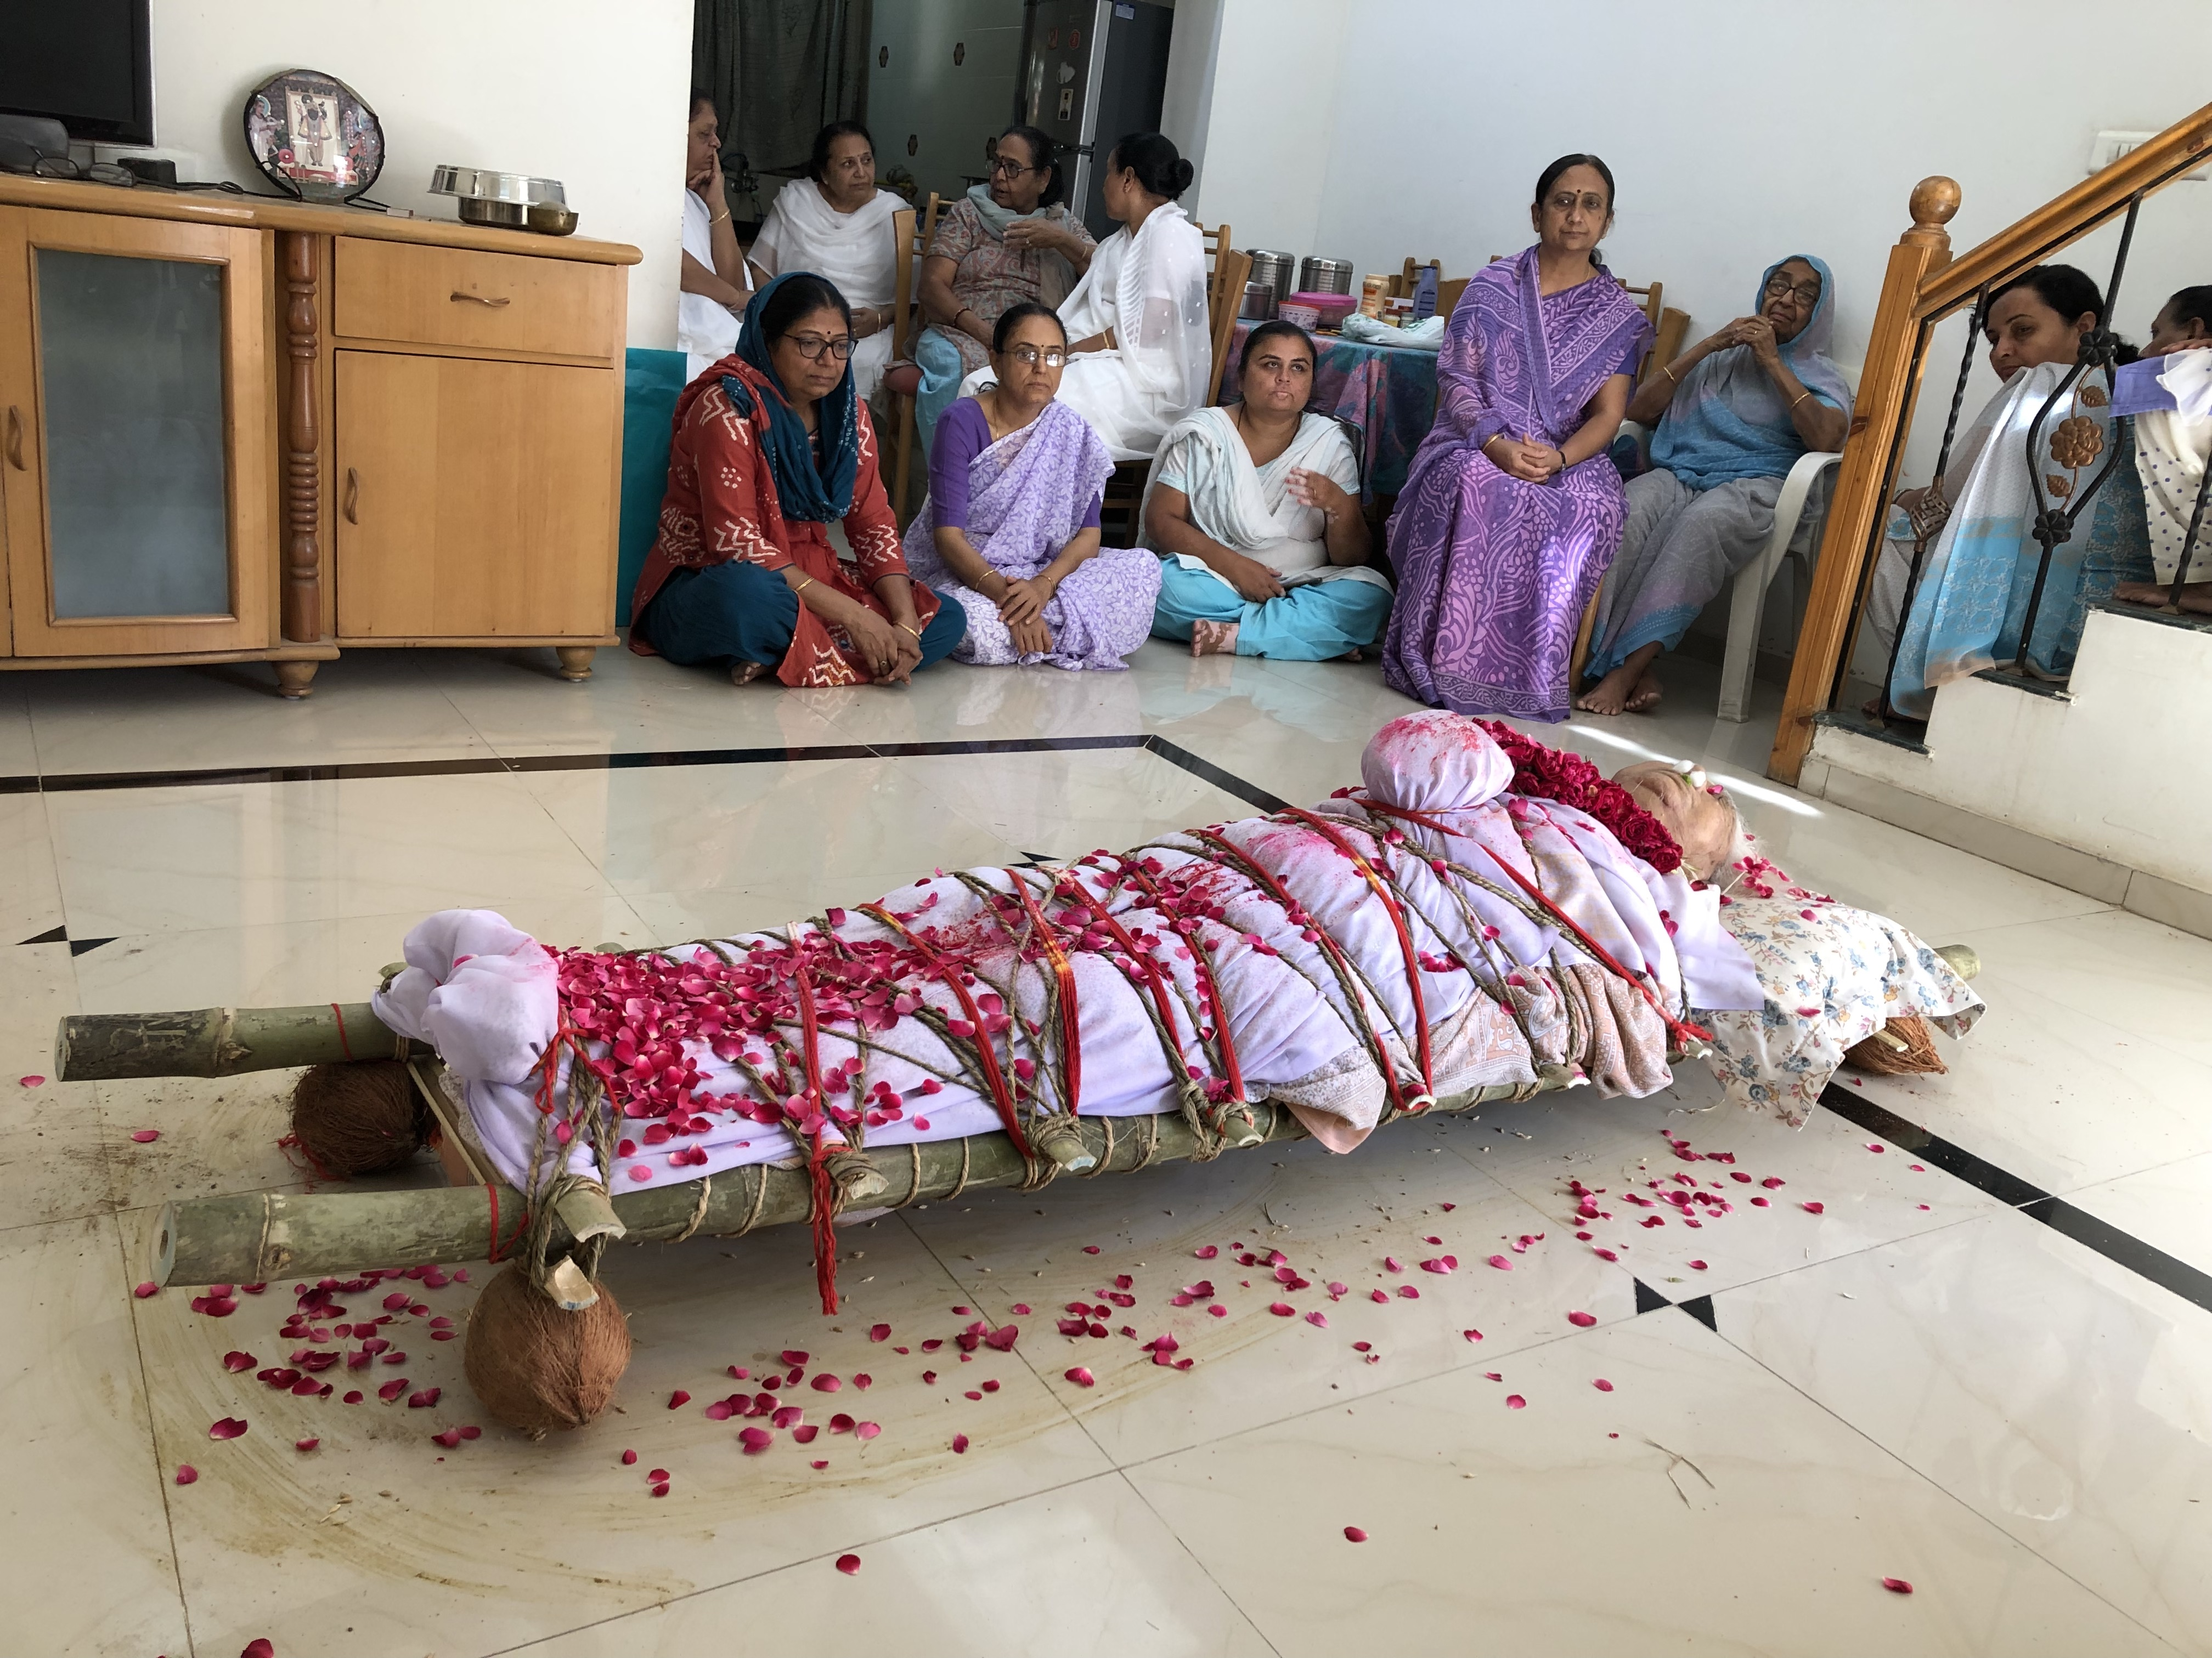
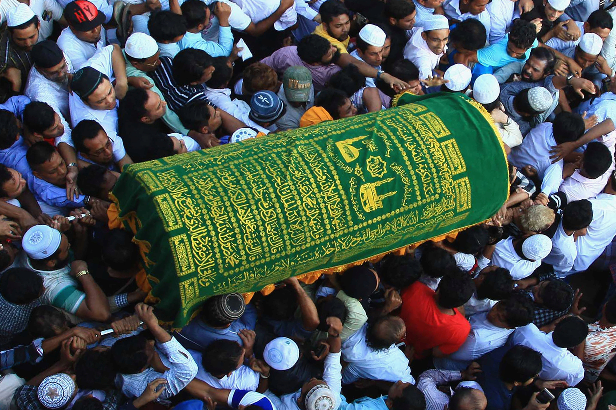
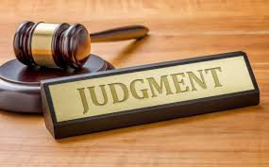
Legal Point for NO BBS #1/2
Shahadah conversion to Islam
Car accident
Page 22
© 2025 InterfaithShaadi

Slide 23

Legal Point for No BBS #2/2
6
Difficult custody of children after divorce if BBS involved
Page 23
© 2025 InterfaithShaadi

Slide 24
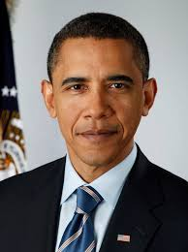
Instead of Religious Labeling (BBS), Empower Children
Why not let interfaith child decides his/her own faith as an adult?
President Barack Obama
Father: Muslim
Mother: Christian
Choice as an adult: Christian
Page 24
© 2025 InterfaithShaadi

Slide 25

Take Home Messages
All religions are not the same
Exclusivism has no place in interfaith marriages
    No fake-conversion
True Pluralism: Raise interfaith child in two faiths
    Interfaith child should be given an option to choose his/her faith
Page 25
© 2025 InterfaithShaadi

Slide 26
Page 26
© 2025 InterfaithShaadi

Slide 27

Fall 2025
Page 27
© 2025 InterfaithShaadi

Slide 28

Author’s Books
Google search Dilip Amin
Page 28
© 2025 InterfaithShaadi

